Slide 1


Exploring Blockchain: Insights into Technology, Applications, and Emerging Trends

Slide 2





Introduction to Blockchain
is a revolutionary technology that enables secure, transparent, and decentralized transactions. This presentation aims to provide insights into its ,
, and
shaping various industries. Understanding these aspects is crucial for leveraging the full potential of this transformative technology.

Slide 3





Understanding Blockchain Technology
is a distributed ledger system that ensures data integrity through cryptographic techniques. Each block contains a ,
timestamp, and transaction data, forming a secure chain. This decentralized nature enhances , reduces fraud, and promotes trust among users.

Slide 4







Key Features of Blockchain
The main
include
of blockchain
,
, , and
. These characteristics make it suitable for various applications, from to supply
chain management, enabling organizations to operate more efficiently and transparently.

Slide 5








Applications of Blockchain
Blockchain has diverse
across industries, including ,
, , and
. Its ability to streamline
operations, enhance , and provide real-time data access is transforming traditional business models and creating new
opportunities.

Slide 6
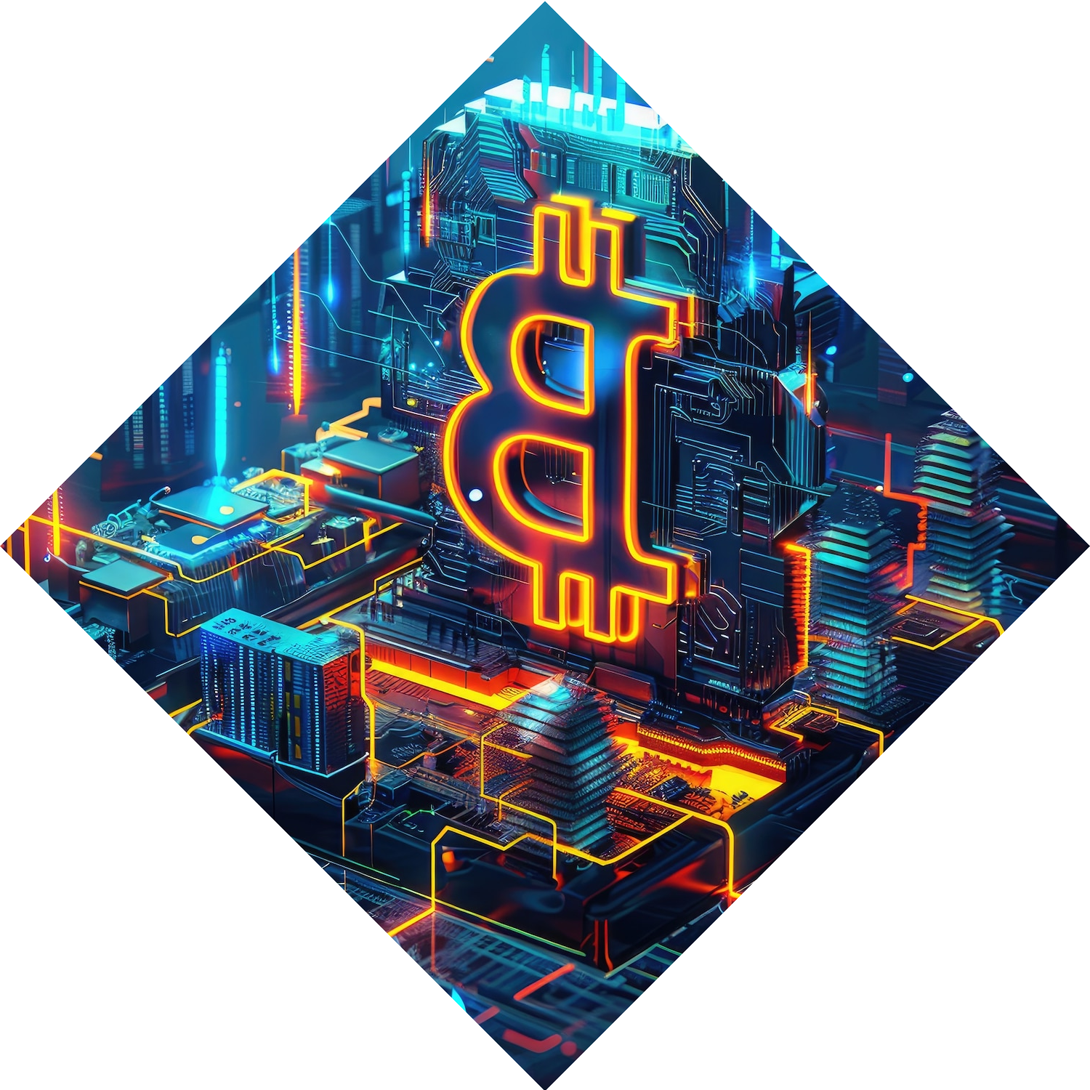



Emerging Trends in
Blockchain
Emerging trends such as (Decentralized Finance), (Non-
Fungible Tokens), and
are reshaping the blockchain landscape. These
innovations are driving
and creating new avenues for businesses to engage with customers and enhance their
service offerings.

Slide 7




Challenges Facing
Blockchain
Despite its advantages, blockchain
faces several
,
, including
, and
. Addressing these issues is crucial for broader adoption and integration into existing systems, ensuring that the technology can reach its full
potential.

Slide 8
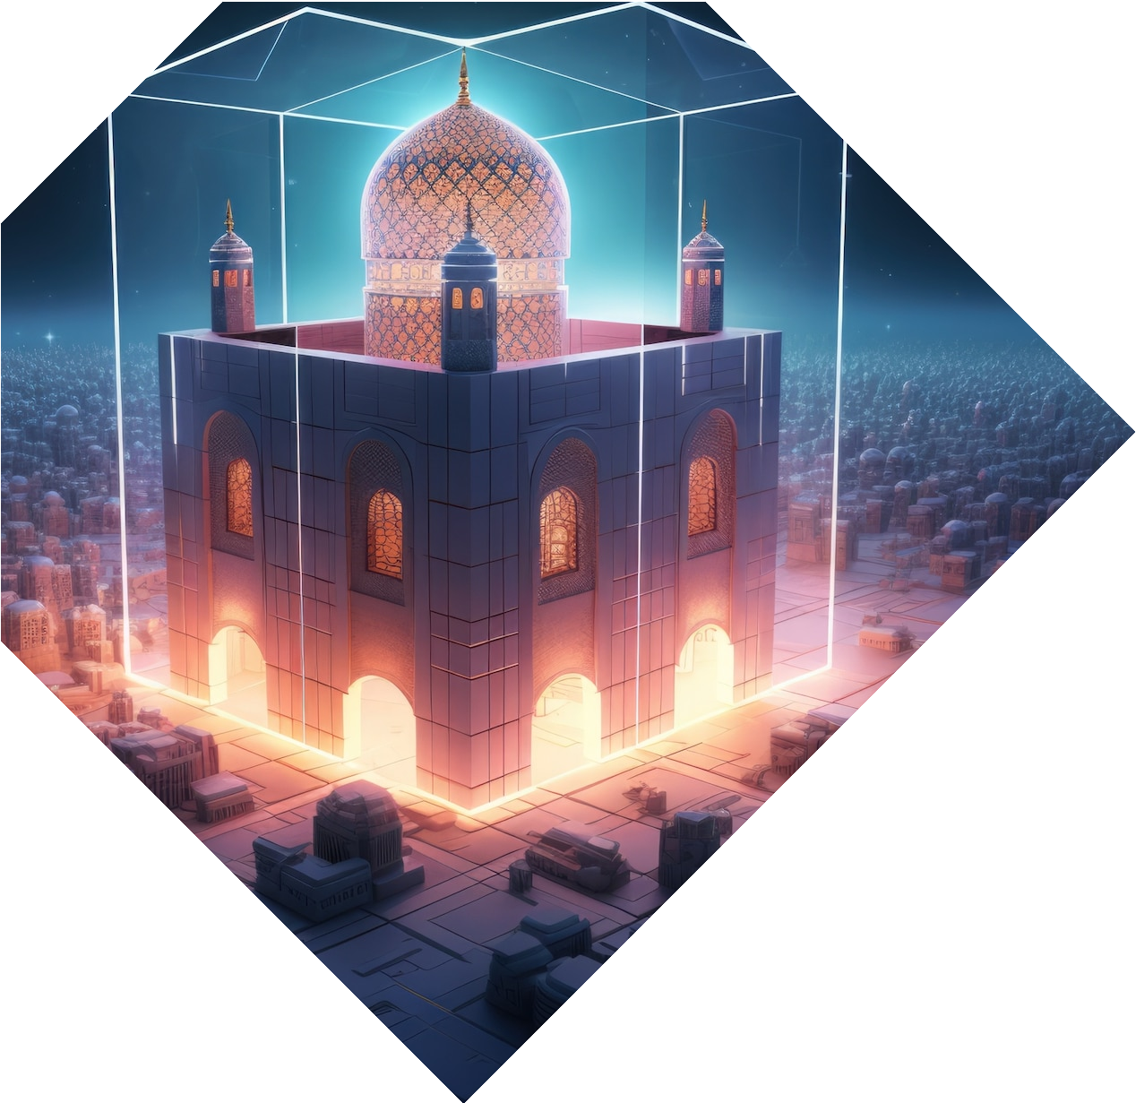




Future of Blockchain Technology
The future of blockchain technology is promising, with ongoing and
aimed at enhancing its
capabilities. As more organizations
recognize its benefits, we can expect increased , innovation, and collaboration across sectors, leading to a more decentralized digital economy.

Slide 9


Conclusion
In conclusion, presents a transformative opportunity across multiple sectors. By understanding its , applications, and emerging trends, stakeholders can harness its potential to drive innovation and efficiency. The journey of blockchain is just beginning, and its impact will be profound.

Slide 10
Thanks!

